Slide 1
Guest Lecture Stanford ME469: An Example of an Unstructured Discretization
Stefan P. Domino
Computational Thermal and Fluid Mechanics
Sandia National Laboratories SAND2018-4536 PE

Slide 2
An Example of an Unstructured Discretization: Outline
Review of CVFEM and EBVC
Sample Diffusion Kernel, CVFEM and EBVC
Conclusions

Slide 3





The Hybrid Control-Volume Finite Element Method (CVFEM)
A combination between the edge-based vertex-centered and FEM is the method known as Control Volume Finite Element ()
A dual mesh is constructed to obtain flux and volume quadrature locations
As with FEM, a basis is defined:
$$T\left(x_{k}\right)≈\sum_{i=1}^{npe}{N_{i}\left(x_{k}\right)T_{i}}$$
$$\frac{∂T\left(x_{k}\right)}{∂x_{j}}≈\sum_{i=1}^{npe}{{\frac{∂N_{i}\left(x_{k}\right)}{∂x_{j}}T}_{i}}$$
Integration-by-parts over test function w:
However, define a test function, w, as a piece-wise constant function (Heavyside) to be 1 inside the dual volume and 0 outside. Gradient is a Dirac-delta function:
Leading to:
$$\int{wρC_{p}\frac{∂T}{∂t}dV+\int{\frac{∂w}{∂x_{j}}λ\frac{∂T}{∂x_{j}}}dV−\int{w}λ\frac{∂T}{∂x_{j}}n_{j}dS=0}$$
$$\frac{∂w}{∂x_{j}}=−n_{j}δ(x_{j}−{xIP}_{j})$$
$$\int{ρC_{p}\frac{∂T}{∂t}dV −\int{λ\frac{∂T}{∂x_{j}}n_{j}}dS=0}$$
Dual-volume definition

Slide 4
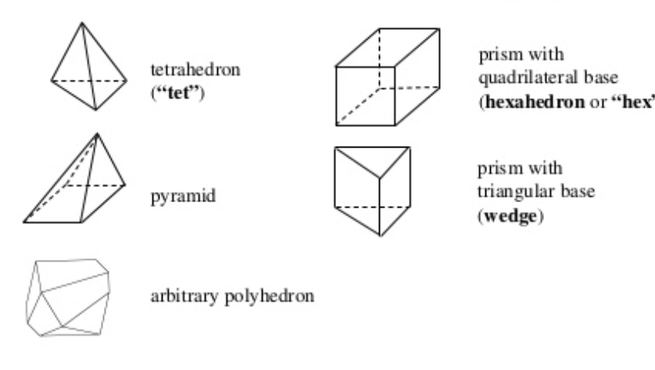
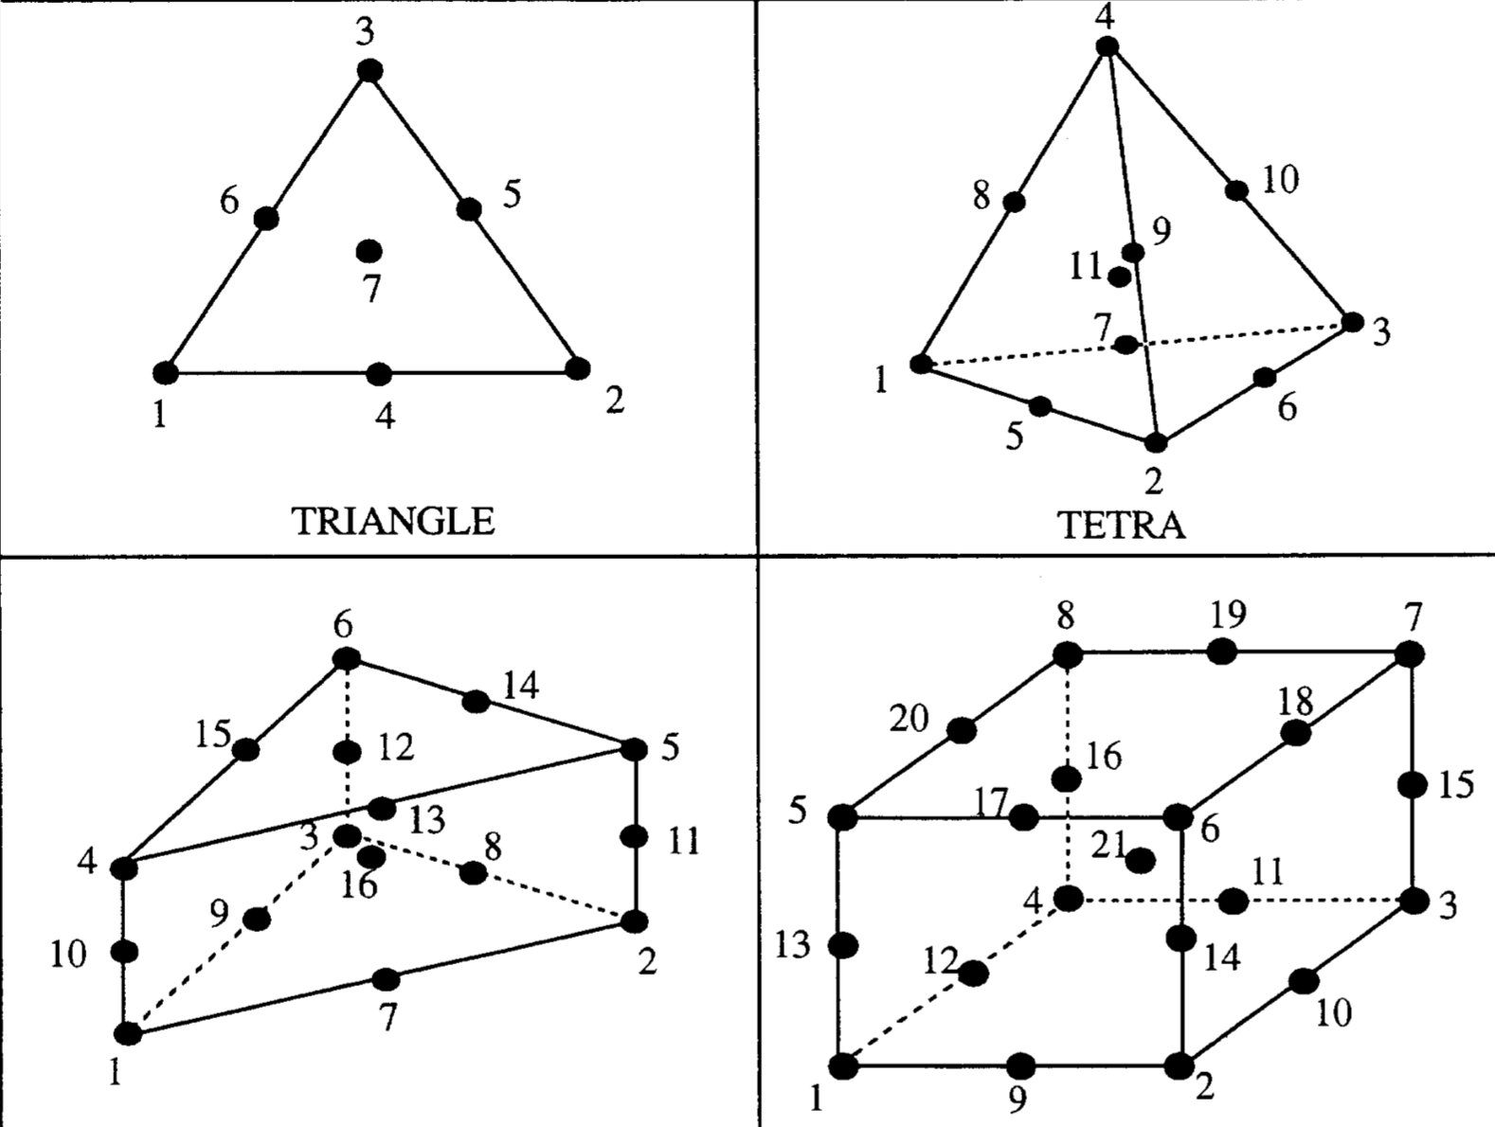
Examples of Various Topologies
Hex8
Tet4
Pyramid5
Wedge6
Arbitrary
Higher-order promoted elements (Hex27, Tet10, Wedge16, Hex64, etc.)

Slide 5
Code Design: Managing a Hybrid Mesh
Attributes:
Three unique topologies: quad_4, quad9, tri3
Iterate a set of “parts” that map to the homogeneous element blocks
Abstract out the integration rule, i.e., AlgTraits::nodesPerElement_, etc.
Create one algorithm per element topology type (avoids resizing)

Slide 6
Sample Nalu ElemKernel: Construction
Constructor defines the fields to gather and the element operations required,
e.g., dndx, area, etc

Slide 7
Sample Nalu ElemKernel: Execution
Design: Elements are “served” to the ElemKernel
Thread-local scratch arrays using
A Kokkos SharedMemView
Templated
SIMD
MD-array rather than error-prone
pointer arithmetic

Slide 8
A CVFEM Diffusion Kernel
// start the assembly
for ( int ip = 0; ip < AlgTraits::numScsIp_; ++ip ) {
// left and right nodes for this ip
const int il = lrscv_[2*ip];
const int ir = lrscv_[2*ip+1];
// compute ip property
DoubleType diffFluxCoeffIp = 0.0;
for ( int ic = 0; ic < AlgTraits::nodesPerElement_; ++ic ) {
const DoubleType r = v_shape_function_(ip,ic);
diffFluxCoeffIp += r*v_diffFluxCoeff(ic);
}
// assemble to rhs and lhs
DoubleType qDiff = 0.0;
for ( int ic = 0; ic < AlgTraits::nodesPerElement_; ++ic ) {
DoubleType lhsfacDiff = 0.0;
for ( int j = 0; j < AlgTraits::nDim_; ++j ) {
lhsfacDiff += -diffFluxCoeffIp*v_dndx(ip,ic,j)*v_scs_areav(ip,j);
}
qDiff += lhsfacDiff*v_scalarQ(ic);
// lhs; il then ir
lhs(il,ic) += lhsfacDiff;
lhs(ir,ic) -= lhsfacDiff;
}
// rhs; il then ir
rhs[il] -= qDiff;
rhs[ir] += qDiff;
}
}
ip = 1
L
R

Slide 9

Equal Order Interpolation Edge-Based Vertex-Centered (EBVC) Finite Volume
All primitives are collocated at the vertices of the elements with equal-order interpolation
A dual mesh is constructed to obtain flux and volume quadrature locations
Classic two-state, “L” and “R” approach provides spatially second-order accuracy
Surface quadrature point (area summed to edge)
Volume quadrature point (sub-vol summed to node)
Same grad-op as CC:
Iterate nodes for volume contributions
Iterate edges for surface flux contribution
$$\frac{∂T}{∂x_{j}}≈\frac{(T_{R}−T_{L})n_{j}}{\left\|{Δx}_{j}\right\|}+O(∆x)$$
T_{L}
n_{j}
T_{R}
Dual-volume definition
Edge-based stencil

Slide 10
An EBVC Algorithm
Regardless of topology (restricted to low-order), edges are unique
Therefore, the topology over which we loop is the edge2 with “L” and “R” nodes, respectively

Slide 11
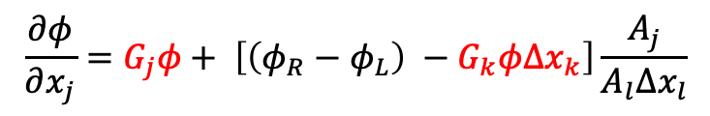
Edge-Based Sample Code
for ( stk::mesh::Bucket::size_type k = 0 ; k < length ; ++k ) {
// get edge
stk::mesh::Entity edge = b[k];
// left and right nodes
stk::mesh::Entity nodeL = edge.edge_node_rels[0];
stk::mesh::Entity nodeR = edge.edge_node_rels[1];
const double viscIp = 0.5*(diffFluxCoeffL + diffFluxCoeffR);
const double qNp1L = *stk::mesh::field_data( scalarQNp1, nodeL );
const double qNp1R = *stk::mesh::field_data( scalarQNp1, nodeR );
double lhsfac = -viscIp*asq*inv_axdx;
double diffFlux = lhsfac*(qNp1R - qNp1L) + nonOrth;
// first left
p_lhs[0] = -lhsfac;
p_lhs[1] = +lhsfac;
p_rhs[0] = -diffFlux;
// now right
p_lhs[2] = +lhsfac;
p_lhs[3] = -lhsfac;
p_rhs[1] = diffFlux;
}
$$\frac{∂φ}{∂x_{j}}=G_{j}φ+ \left[\left(φ_{R}−φ_{L}\right) −G_{k}φ∆x_{k}\right]\frac{A_{j}}{A_{l}∆x_{l}}$$
L
R
x

Slide 12
An Example of an Unstructured Discretization: Conclusions
Decide on the topology over which one must loop to assemble the PDE discrete contributions
Provide a code interface that supports this topology loop with minimal resizing
Solve in residual form: AΔx = -Res

